Slide 1

SHAMSHABAD · CIRCLE 14
Property Tax Data Analysis Report
Residential Type I · 2,000 properties analyzed

Slide 2
Recovery is stable, but ₹9.06 lakh remains exposed
The circle has realised 77.51% of total tax demand. The remaining balance is concentrated enough to target.
₹40,29,396
₹31,23,290
Total tax demand
Collection realised
₹9,06,106
77.51%
Outstanding balance
Aggregated recovery efficiency

Slide 3
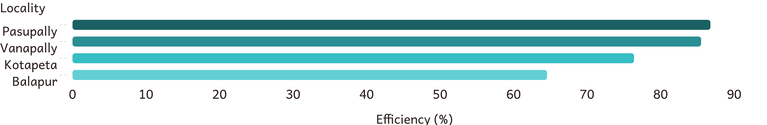
Pasupally and Vanapally set the pace
Both localities exceed 85% efficiency. Balapur trails at 64.55%.
Locality | Bill Collector Name | Demand (₹) | Collection (₹) | Outstanding (₹) | Efficiency (%)
Pasupally | Tarun | 9,20,820 | 7,99,122 | 1,21,698 | 86.78
Vanapally | Raju | 9,92,464 | 8,48,668 | 1,43,796 | 85.51
Kotapeta | Arun Kumar | 9,24,909 | 7,06,520 | 2,18,389 | 76.39
Balapur | Vijay Kumar | 11,91,203 | 7,68,980 | 4,22,223 | 64.55

Slide 4
Recovery risk is concentrated, not widespread
The locality pattern points to a focused intervention rather than a circle-wide recovery problem.
LEADING LOCALITIES
MID-LOCALITY
Pasupally · 86.78%
Kotapeta · 76.39%
Vanapally · 85.51%
Between the leading localities and Balapur.
Both cross the 85% collection mark.
LARGEST DRAG
Balapur · 64.55%
Creates the largest drag on circle performance.

Slide 5


Placeholder mobile numbers weaken outreach
Ledger records include standard placeholder strings in mobile contact fields. That compromises automated outreach and mobile payment campaigns.
PLACEHOLDER CONTACT
OUTREACH IMPACT
9999999999
Automated outreach
Mobile payment campaigns are weakened when contact fields are not usable.
Standard placeholder string in mobile contact fields.

Slide 6
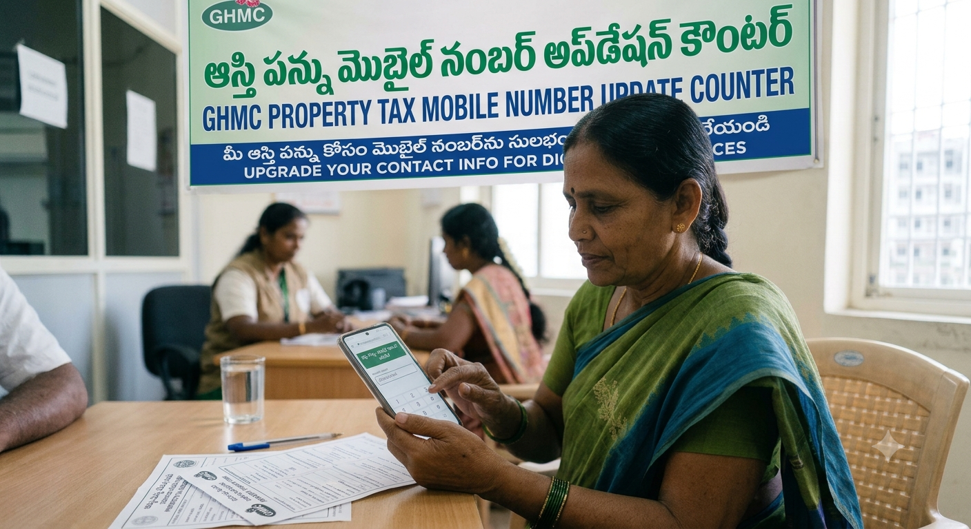
THE RECOVERY PLAY
1
Two moves can close the gap
Launch a field-data enrichment
task force
Replace placeholder numbers with validated mobile contacts.
2
Transfer the collection playbooks
Move the Pasupally and Vanapally approach
to trailing teams, starting with Balapur.

Slide 7

Thank You

